Slide 2
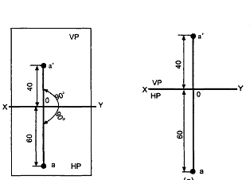
Point A is 40 mm above HP and 60 mm in front of v.P. Draw its front and top view.

Slide 3
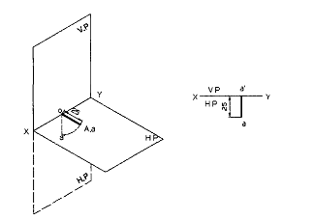
Draw the projections of a point A lying on HP and 25mm in front of v.P.

Slide 4
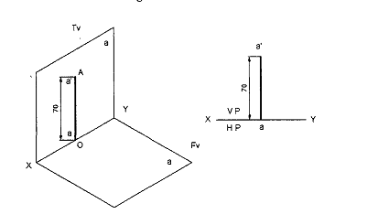
Draw the projections of a point A lying on v.p and 70 mm above HP.

Slide 5
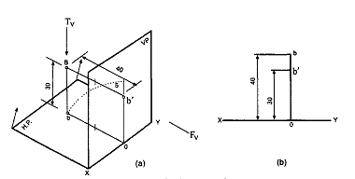
A Point B is 30 mm above HP and 40 mm behind v.p Draw its projection

Slide 6
Draw the orthographic projections of the following points.
(a.) Point Pis 30 mm. above H.P and 40 mm. in front ofVP
(b.) Point Q is 25 mm. above H.P and 35 mm. behind VP
(c.) Point R is 32 mm. below H.P and 45 mm behind VP
(d.) Point Sis 35 mm. below H.P and 42 mm in front of VP
(e.) Point T is in H.P and 30 mm. is behind VP
(f.) Point U is in v.p abd 40 mm. below HP
(g.) Point V is in v.p and 35 mm. above H.P
(h.) Point W is in H.P and 48 mm. in front of VP

Slide 7
